Slide 1

Welcome to all
for the Advertising Online lecture
By
Dr. Dhiraj Ovhal
HOD of Commerce

Slide 2
Syllabus for Semester -3
Advertising
Sr.No | Chapter name
1 | Introduction to advertising
2 | Ad Agency
3 | Economic and Social Aspects of Advertising
4 | Brand Building and Special purpose of advertising

Slide 3
Question Paper Format
All questions are compulsory Total 3 Hours & Marks 100
Q.1. Objectives as follow
A. Multiple Choice Question any 10/12 ………………..Total Mark 10
B. True /False …..any 10 / 12 ………………………………..Total Mark 10
Q.2 Write any 2 out of 3 ………from Chapter 1………………..Total Mark 15
Q.3 Write any 2 out of 3 ………from Chapter 2………………..Total Mark 15
Q.4 Write any 2 out of 3 ………from Chapter 3………………..Total Mark 15
Q.5 Write any 2 out of 3 ………from Chapter 4………………..Total Mark 15
Q. 6 Short Notes any 4 out of 6 … from all Chapters … Total Mark 20

Slide 4
Q.1 Write Meaning, Definition and Features of Advertising
Meaning:- The word advertising comes from Latin word “Advertere” which means to turn the mind towards .
The primary goal of advertising is to attract attention of audience and induce them to purchase advertising products and services.
Definition:- Definition AMA defines (American Marketing
Association)
“Any paid form of Non personal presentation,
Promotion of ideas, goods and service by an
indentified sponsor.”

Slide 5
Features/Characteristics/ Natures/ Objectives/Essential
(Shortcut to remember )
Definition has 4 features point +
CAT ABCDEF
1) Paid form
2) Non personal presentation Definition has 4 features point
3) Ideas, goods and service
4) Indentified Sponsors
5) Creativity
6) All pervasive
7) Target Market
8) Arts, Science & Profession
9) Build Image CAT, ABCDEF
10) Create awareness
11) Diverse groups
12) Elements of marketing mix
13) Facilities to the customers

Slide 6
1.Paid Form
It is paid form concept.
Advertiser/Seller/Manufacture/Real
Owner
Adverting Campaign
Media
Publicity is not paid form.

Slide 7
2. Non personal presentation
It is non personal presentation of commercial message
The basic objectives to convey advertising messages to the audience and induce them to purchase
advertising products/services
Salesmanship is personal form

Slide 8
3.Ideas, Goods and Services
Goods :- Tangible things such as Mobile, Car, Soap, etc.
Services :- Intangible Services such as Banking, Telecommunication, Insurance, etc.
Ideas:- Pulse polio campaign, Blood donation, Save Girl child, Stay Safe & Stay Home ---- Corona Awareness

Slide 9
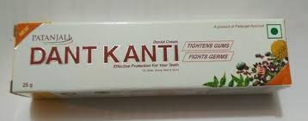
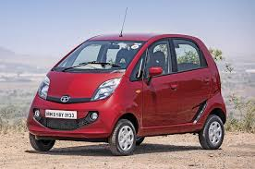
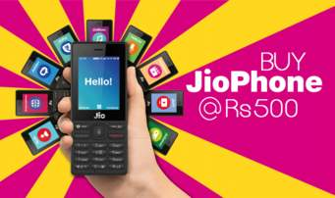
Indentified sponsors:-
For Example :- The Owner/ Seller/ Manufacture/
Retailer/ Govt.Orgn./ Hopsitals/
Jio Phone . Nano Car, Dant Karanti

Slide 10
5. Creativity :-
New concept of ads
Innovative / Unique things
for example:- ZOO ZOO ads, Menthos

Slide 11
6. All pervasive:-
Universal application
Applicable to business as well as
Non-business organisation
For examples:- SYBCOM admission
form and Notice ..
Attended Zoom meeting

Slide 12
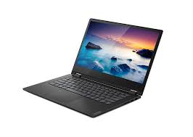
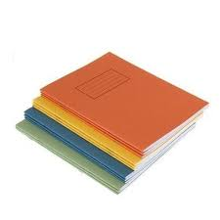
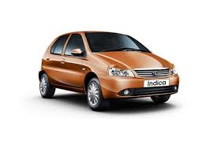
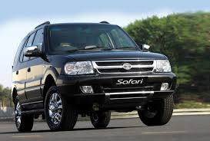
7. Target Market:- One can not sell everything to everyone.

Slide 13
8. Arts, Science & Profession
Arts:- It is required skills & Talent to prepare ad campaign
Science :- It is part of social science which is basically deals with human being ( Customers)
Profession:- Now days due to tough competition in the market, for market share it is seeking helps from profession ad agencies

Slide 14
9. Build Image:-
Increase Name and reputation of Brand.
Use Brand personalities to promote products like
Pappu Paas Ho Gaya– Cadbury dairy milk..
Harpic– Akashay Kumar

Slide 15
10. Create Awareness :-
Not only provide details but also
Mention whether Environmentally friendly or not.
All contents /ingredients information.
Use of products .
Price & Features of the products,etc.

Slide 16
11. Diverse groups
Primary applicable to Customers
Other stakeholders
Wholesaler, Retailers, Supplier, etc,
Try to covert Audience into prospects
and prospects into customers

Slide 17
12. Elements of marketing mix
Marketing Mix means “4 P”S
Product
Price
Place
Promotion

Slide 18
13. Facilities to the customers
To help
Provide all details like price ,
features, quality, etc,
Easy for customers to select right product as per requirement / budget
For example:-
iphone :- Luxury mobile/ Best quality
Selfy camera :- Oppo Phone

Slide 19
Features/Characteristics/ Natures/ Objectives/Essential
(Shortcut to remember )
Definition has 4 features point +
CAT ABCDEF
1) Paid form
2) Non personal presentation Definition has 4 features point
3) Ideas, goods and service
4) Indentified Sponsors
5) Creativity
6) All pervasive
7) Target Market
8) Arts, Science & Profession
9) Build Image CAT, ABCDEF
10) Create awareness
11) Diverse groups
12) Elements of marketing mix
13) Facilities to the customers

Slide 20
Thank You

Slide 21
Attendance Link
https://forms.gle/U4Da9ykpniL3tpCdA

